Slide 1
Industry Oriented Mini Project
MID- 2 REVIEW

Slide 2
BATCH - 1
Roll Number Name of the Student
23QM1A6692 Peddina Venkat Kalyan
23QM1A6681 Nallabolam Mounika
23QM1A6685 Panasa Chandra Kaushik Goud
23QM1A6689 Patel Nanda Kishore Reddy

Slide 3
Title
DeepShield: Multi-Modal AI-Based Deepfake Detection System for Identifying Fake Video, Audio, and Image Content.

Slide 4
Problem Identification
We are living in a time where seeing is no longer believing. With the rapid growth of generative AI, it has become easy to create highly realistic fake videos, images, and audio. While this technology has many positive uses, it is also being misused for spreading misinformation, committing fraud, and stealing identities. The main challenge is that humans can no longer reliably distinguish between real and fake content. Therefore, there is a strong need for an automated system to detect such content and restore trust in digital media.
Core Problem
Lack of an intelligent, automated system to detect and classify deepfake content efficiently
Absence of a unified solution that can handle multiple media types (video, image, audio)

Slide 5
Objectives
Our goal is to design, train, and deploy an intelligent system that acts as a digital forensic expert. The system will automatically analyze incoming media—whether it's an image, an audio clip, or a video—and determine its authenticity. By examining subtle, invisible artifacts left behind by AI generators, the system will output a definitive "real or fake" confidence score, empowering users to verify media instantly.

Slide 6
Literature Survey
S.No | Paper Title | Year | Journal | Methodology/Algorithm | Finding | Drawback
1 | Exploring autonomous methods for deepfake detection: A detailed survey on techniques and evaluation | 2025 | Heliyon (Elsevier / Cell Press) | Reviewed different ways models like CNNs and GANs catch deepfakes across images, video, and audio. | Proved that looking at audio and video together works way better than just checking one at a time. | It’s just a review paper, so it doesn't offer a new model. It also points out that current detectors still struggle when tested on new, unseen data.
2 | From Single-modal to Multi-modal Facial Deepfake Detection: Progress and Challenges | 2025 | arXiv Preprint | Looked at the shift from simple image-only detectors to complex models that analyze video, audio, and text together using modern AI. | Combining different media types is great for catching tiny mistakes, like when a person's lip movements don't perfectly match the audio. | Running these complex, multi-layered models takes a ton of computing power and requires perfectly synced data to work right.
3 | Deepfake Detection via Spatial-Frequency Attention Network (SFANet) | 2025 | IEEE Transactions on Consumer Electronics | Built a dual-branch network that uses wavelet transforms to look at both the normal image pixels and the hidden frequency patterns. | Got excellent results on major datasets by catching weird frequency glitches that are completely invisible to the naked eye. | If a video gets heavily compressed (like when uploaded to social media), those frequency glitches disappear, making the model less accurate.

Slide 7
4 | WaViT-CDC: Wavelet Vision Transformer With Central Difference Convolutions | 2025 | IEEE Open Journal of Signal Processing | Combined the power of Vision Transformers with standard convolution techniques to spot deepfakes in both spatial and frequency domains. | This hybrid setup is really good at noticing both obvious visual mistakes and subtle, global frequency issues. | Because it uses Transformers, the model is pretty heavy and requires a lot of memory, making it tough to run on basic hardware or phones.
5 | Deepfake-Eval-2024: A Multi-Modal In-the-Wild Benchmark of Deepfakes | 2025 | arXiv Preprint | Tested the best current deepfake detectors against thousands of hours of brand-new, real-world deepfakes from 2024/2025. | Showed that even top-tier models fail miserably (up to a 50% drop in accuracy) when dealing with new types of deepfakes found on the internet. | It's only a testing benchmark. It proves that current models are failing but doesn't actually provide a fix for the problem.
6 | A Survey on Multimodal Deepfake Detection System | 2026 | Atlantis Press (Springer) | Discussed the theory behind how we should combine (or "fuse") audio, video, and image data to build better detectors. | Found that the hardest part of building these systems is getting the audio and video perfectly synced and finding enough good data to train on. | Mostly focuses on theory and discussion rather than actual testing or providing solid benchmark numbers.

Slide 8
Dataset Identification (Video Datasets)
Dataset Category | Source | Description | Purpose | Link
DFDC (Video) | Kaggle | Large-scale dataset containing real and deepfake videos; considered a gold standard benchmark | Train and evaluate deepfake detection models on diverse, real-world data | https://www.kaggle.com/c/deepfake-detection-challenge
FaceForensics++ (Video) | Technical University of Munich | Dataset with multiple types of facial manipulations (Deepfakes, FaceSwap, Face2Face, NeuralTextures) | Test and benchmark face manipulation detection techniques | https://github.com/ondyari/FaceForensics#access
Celeb-DF (Video) | University at Buffalo | High-quality deepfake videos with minimal visible artifacts | Evaluate model performance on realistic and hard-to-detect deepfakes | https://github.com/yuezunli/celeb-deepfakeforensics
DeepFakeTIMIT | University of Naples | Low & high-quality deepfake videos | Evaluate model robustness | https://conradsanderson.id.au/vidtimit/

Slide 9
Dataset Identification(Image Datasets)
Dataset Category | Source | Description | Purpose | Link
CelebA | Google / CUHK | Large dataset of celebrity faces | Train face-based models | https://mmlab.ie.cuhk.edu.hk/projects/CelebA.html
FFHQ (Flickr-Faces-HQ) | NVIDIA | High-quality human face images | Train GAN detection models | https://github.com/NVlabs/ffhq-dataset
StyleGAN Generated Dataset | NVIDIA | AI-generated fake faces | Detect synthetic images | https://github.com/NVlabs/stylegan
Real vs Fake Face Dataset | Kaggle | Mix of real and fake face images | Binary classification (real/fake) | https://www.kaggle.com/c/fake-faces

Slide 10
Dataset Identification(Audio Datasets)
Dataset Category | Source | Description | Purpose | Link
ASVspoof 2021 | Zenodo | Synthetic & spoofed speech dataset | Train audio deepfake detection | https://zenodo.org/record/4837263
Fake-or-Real (FoR) | Kaggle | Real and AI-generated voice samples | Binary classification | https://www.kaggle.com/datasets/mohammedabdeldayem/the-fake-or-real-dataset
WaveFake | University of Edinburgh | Fake audio generated using TTS models | Detect AI-generated voices | https://github.com/RUB-SysSec/WaveFake
LibriSpeech + Fake Audio | OpenSLR | Real speech dataset (baseline) | Compare real vs fake audio | https://www.openslr.org/12

Slide 11
Tool & Technology Selection
AI/ML Stack
Python:
Main programming language used for AI development
Easy integration with ML libraries
PyTorch :
Frameworks used to build, train, and test deep learning models
Provide GPU support for faster computation
EfficientNetV2 (local details):
Used for image classification
Detects fake images by analyzing
Facial inconsistencies
Texture and pixel-level artifacts
MTCNN ( Multi-task Cascaded Convolutional Network):
Used for face detection
Extracts faces from images/videos

Slide 12
Tool & Technology Selection
Wav2Vec:
Processes raw audio signals
Extracts deep audio features
Helps detect AI-generated or cloned voices
Full-stack Development:
React + tailwind CSS:
Builds user interface
Provides responsive and clean design
Flask:
Backend framework
For API requests
Model execution
Communication between frontend and AI
MongoDB:
NoSQL database
Stores: User uploads, Detection Results, logs

Slide 13
Project Planning
Workflow:
Step 1: Problem Identification
Identify issue of increasing deepfake misuse
Define need for multi-modal detection
Step 2: Literature Survey
Study existing models (CNN, RNN, ViT)
Analyse limitations of single-modality systems
Step 3: Problem Statement & Objectives
Define system goals
Multi-modal detection for image, video, audio
Step 4: System Requirements & Packages ⭐
Programming Language: Python
Libraries: TensorFlow, PyTorch.
Models: EfficientNetV2, MTCNN.
Audio Tools: Wav2Vec.
Frameworks: Flask , React
Hardware: GPU (for faster training)
Step 5: Dataset Identification & Collection
Select datasets (DFDC, Celeb-DF, ASVspoof)
Gather real and fake samples
Step 6: Data Preprocessing
Face detection (MTCNN)
Frame extraction (videos)
Audio → spectrogram conversion
Step 7: Model Development
Image → EfficientNetV2
Video → Temporal models
Audio → Wav2Vec
Step 8: Model Integration
Combine outputs from all modalities
Apply fusion technique
Step 9: Testing & Evaluation
Evaluate accuracy
Compare real vs fake predictions
Step 10: Final Deployment
User uploads media
System outputs result (Real/Fake)

Slide 14
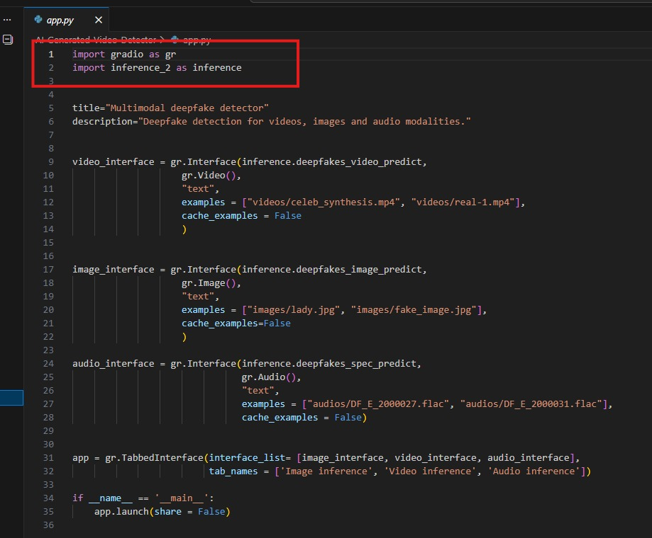
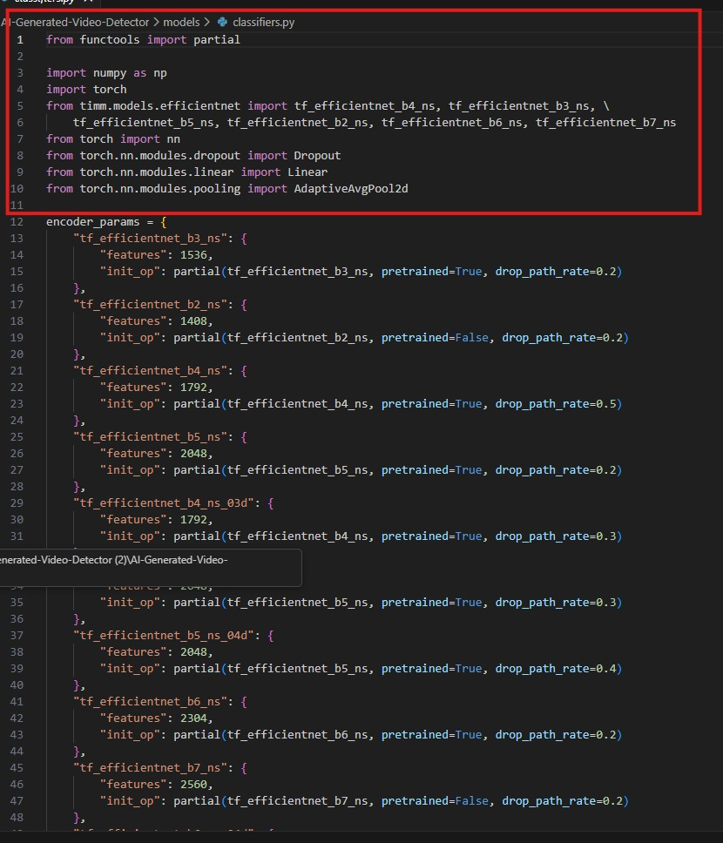
IMPLEMENTATION PROCESS
PYTHON PYTORCH

Slide 15
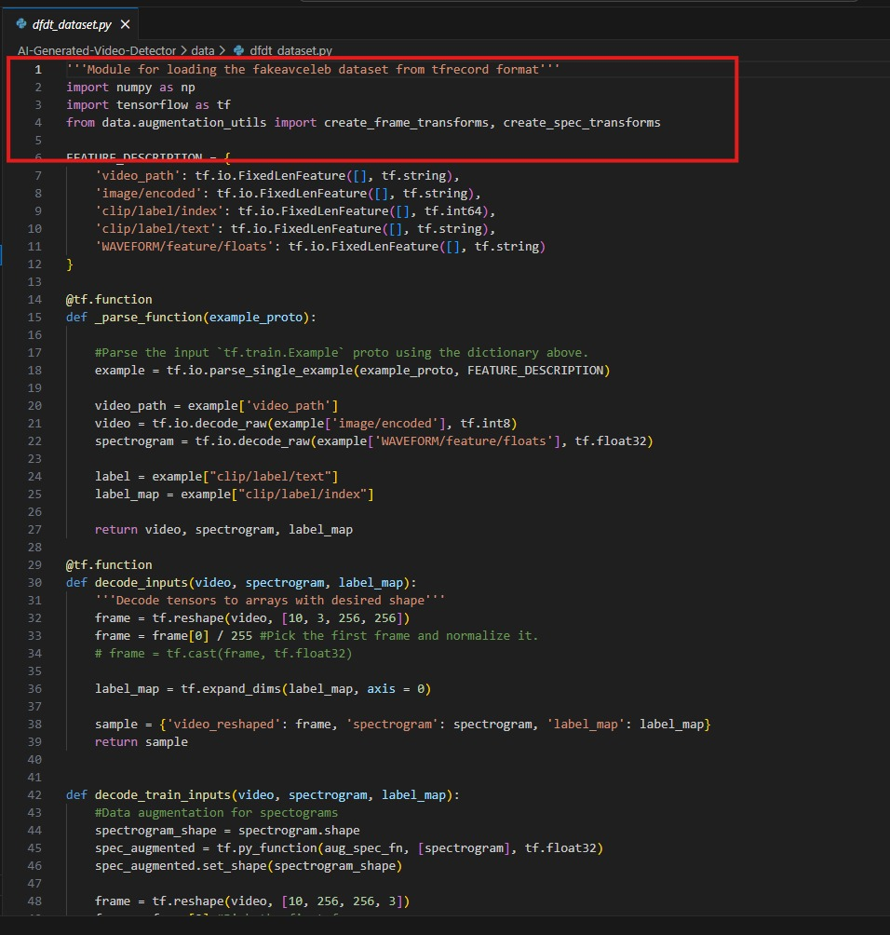
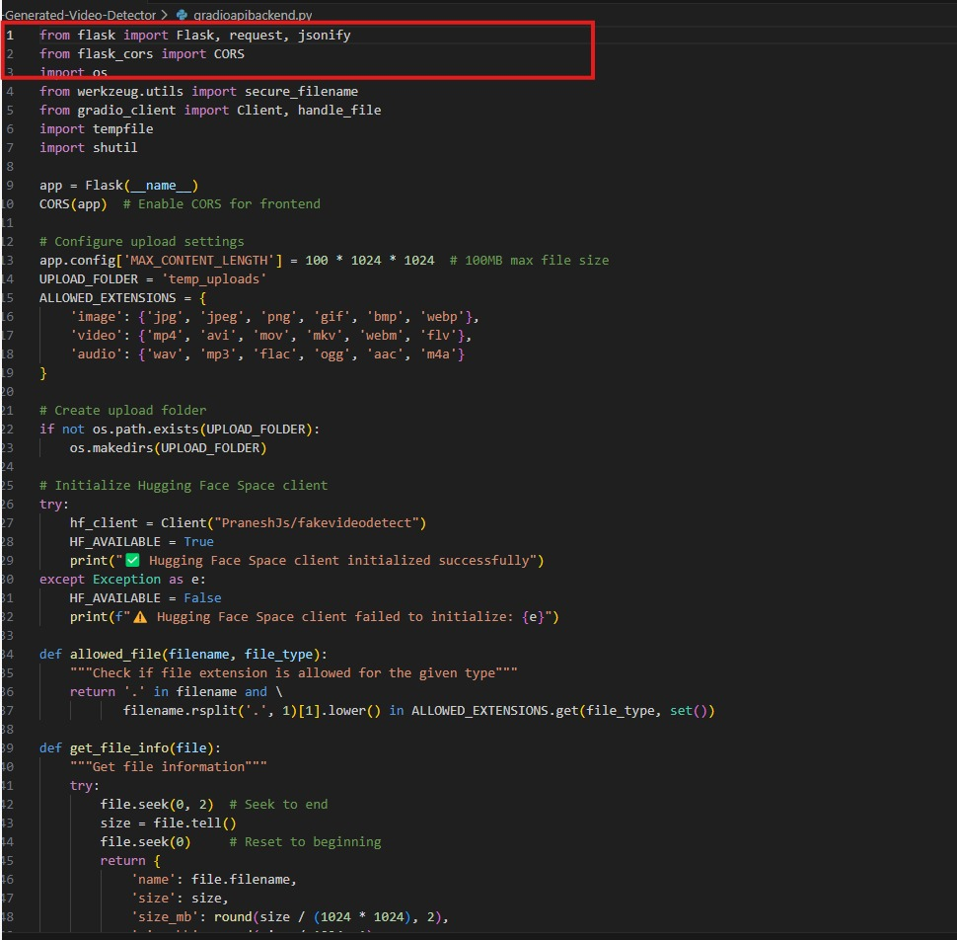
IMPLEMENTATION PROCESS
TENSORFLOW FLASK

Slide 16
Data preprocessing
Collected real and AI-generated image, video, and audio datasets from multiple sources
Removed duplicate, corrupted, blurred, and low-quality media files
Resized images and extracted facial regions using MTCNN face detection
Extracted frames from videos at regular intervals for frame-level analysis
Detected and cropped faces from video frames to focus on manipulated regions
Cleaned audio using noise reduction and normalization techniques
Converted audio signals into spectrograms for frequency pattern analysis
Labeled all samples as Real or Fake (AI-Generated)
Applied data augmentation techniques such as rotation, flipping, zooming, and brightness adjustment
Normalized extracted features for stable and efficient model training
Split dataset into 80% training and 20% testing data for evaluation

Slide 17
FEATURE ENGINEERING
Image Features (MTCNN + EfficientNetV2)
Faces extracted from images using MTCNN face detection
Images resized and normalized before feature extraction
EfficientNetV2 used to learn deep visual patterns from facial regions
Detects inconsistencies such as:
Blurred facial boundaries
Artificial skin textures
Lighting mismatches
GAN-generated artifacts
High-level spatial features extracted for Real vs Fake classification
Video Features (OpenCV + Frame Analysis)
Videos divided into multiple frames using OpenCV
Face detection applied on each frame for frame-level analysis
Extracted temporal and spatial inconsistencies across frames
Features analyzed include:
Facial motion irregularities
Frame texture inconsistencies
Flickering artifacts
Abnormal eye blinking patterns
Frame-by-frame predictions aggregated for final video classification

Slide 18
FEATURE ENGINEERING
Audio Features (Librosa)
Audio extracted from videos and cleaned using noise reduction
Converted into spectrograms for frequency-domain analysis
Extracted features include:
MFCC coefficients
Pitch variation
Spectral contrast
Energy distribution
Voice frequency irregularities
Helps detect AI-generated or synthetic speech patterns

Slide 19
Experimentation
Hyperparameter Tuning: Conducted extensive tuning on batch sizes, learning rates (using ReduceLROnPlateau scheduling), and dropout rates to optimize convergence.
Loss Function Strategy: Utilized Cross-Entropy Loss combined with an annealing strategy to balance the weight of the audio and visual branches during training.
Ablation Studies: Tested the model's performance using only visual data vs. only audio data to prove that the Hybrid Dual-Branch approach yields superior accuracy.

Slide 20
MODEL IMPLEMENTATION
Primary Model: EfficientNetV2 + Multimodal Deep Learning
EfficientNetV2 used as the primary deep learning model for image and video classification
Provides high accuracy with lower computational complexity
Efficiently captures deep facial manipulation patterns and synthetic artifacts
Performs well on large-scale visual datasets with faster training speed
Suitable for real-time deepfake detection applications
Robust against noise, compression artifacts, and varying media quality
Supporting Technologies
MTCNN for accurate face detection and facial region extraction
OpenCV for video frame extraction and temporal analysis
Librosa for audio preprocessing and feature extraction
PyTorch framework used for model training and optimization

Slide 21
PERFORMANCE EVALUATION
Evaluated the model using standard classification metrics:
Accuracy
Precision
Recall
F1-Score
Confusion Matrix
Training and testing performed on preprocessed multimodal datasets containing image, video, and audio samples
EfficientNetV2 achieved high detection accuracy for identifying AI-generated media content
Frame-level video analysis improved temporal consistency detection and reduced false predictions
Compared performance with baseline models such as:
CNN
ResNet50
MobileNetV2

Slide 22
PERFORMANCE EVALUATION
EfficientNetV2 provided:
Better feature extraction
Faster convergence
Higher classification accuracy
Improved generalization on unseen data
Confusion matrix analysis showed strong performance in distinguishing:
Real Media
AI-Generated / Fake Media
Data augmentation and feature normalization helped reduce overfitting and improved model robustness
Final multimodal fusion strategy increased overall detection reliability by combining image, video, and audio predictions

Slide 23
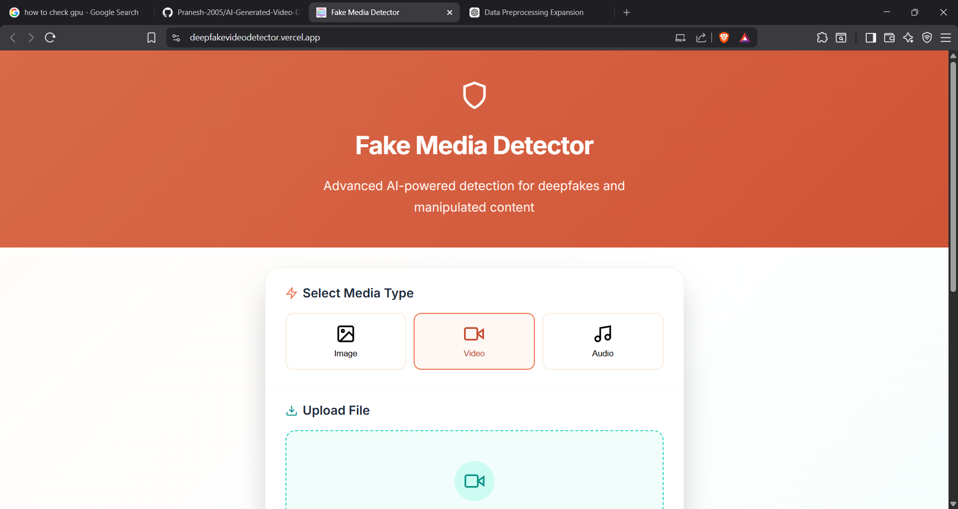
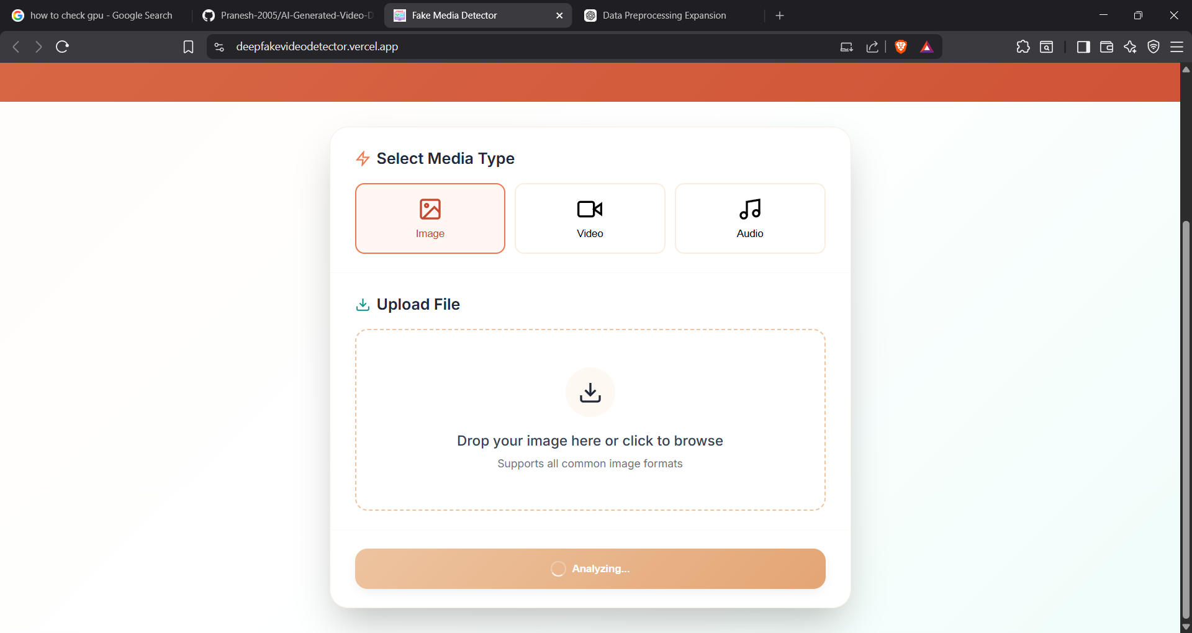
RESULTS ANALYSIS
The system successfully detected fake images, videos, and audio files
Multi-modal detection improved overall system accuracy
EfficientNetV2 accurately detected manipulated images
Wav2Vec effectively identified AI-generated voices
Outcome
High accuracy achieved in deepfake detection
System provided reliable Real or Fake predictions
Improved performance across different media types

Slide 24
Code Quality
Followed clean and modular architecture for frontend and backend development
Used reusable React components and custom hooks for better maintainability
Maintained separation of concerns using dedicated processing modules:
video_processor.py
audio_processor.py
fusion.py
ai_detector.py
Applied proper naming conventions, indentation, and structured coding standards
Implemented exception handling using try/except blocks to prevent application crashes
Added validation and user-friendly error handling for all API requests and uploads
Reduced redundant computations and optimized media processing workflows
Used React Query for efficient API state management and caching
Maintained scalable folder structure for datasets, models, APIs, and frontend components
Included comments and documentation for important functions and workflows
Used GitHub version control for collaboration, tracking, and code management
Ensured compatibility between preprocessing, feature extraction, model inference, and frontend integration

Slide 25
THANK YOU!

